Slide 1
Access your Account
Use Google Chrome to go to: https://login.smasheducation.com/login
Username: your university email address
Password: smash

Slide 2
Payment
Use Google Chrome to use the lab.
Cost is $35
Don’t panic when the system shows the amount as $48 CAD (Canadian dollars).
The actual amount charged is $35 USD.

Slide 3
Before You Start The Diagnostic Test
Use the browser, NOT THE APP.
Find a location with a very strong and stable internet connection.
You need to have sufficient time to answer the test without stopping.

Slide 4
During The Diagnostic Test
Students that do not finish the test because of an interruption, need to log in to their account again and look for an orange button that says RESUME TEST.
If that button does not respond, you will need to start the test again.
If you believe that your placement is not what you expected after you finish the test, you will need to start the test from the beginning.

Slide 5
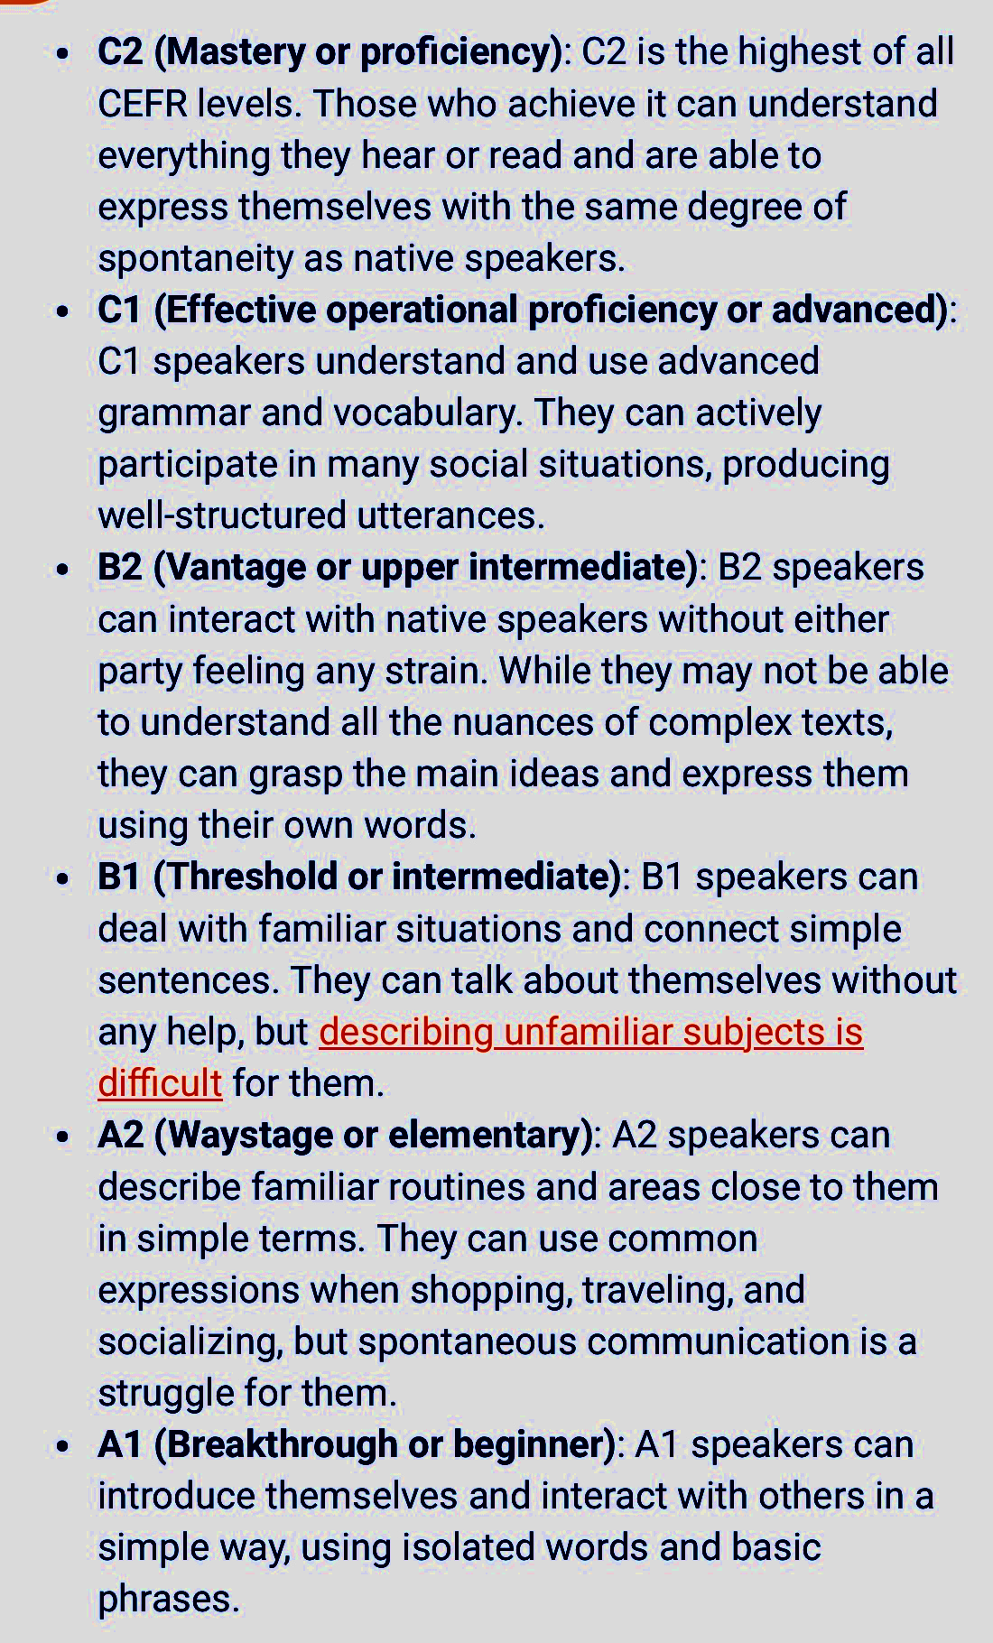
The diagnostic test serves as a placement tool.
CEFR - Common European Framework of Reference for Languages
Missions are assigned based on the proficiency revealed after the test.
The levels we are using: A, B, and C

Slide 6
During The Diagnostic Test
Students that do not finish the test because of an interruption, need to log in to their account again and look for an orange button that says RESUME TEST.
If that button does not respond, you will need to start the test again.
If you believe that your placement is not what you expected after you finish the test, you will need to start the test from the beginning.

